Slide 1
Care Connect
Project by
B6
Sidharth Thejas
S R Angelo Antony
Shiva Surendran
Sai Anand K
Guide : Fameela K A

Slide 2
Why CareConnect?
In this busy world its tough to always keep an eye on our loved ones in isolation , especially elders.
CareConnect acts as a solution to keep your mind at ease.
The app continuously monitors the phone activity of the benefactor (the person under isolation) and alerts the caretaker if there is long inactivity
The caretaker can send messages to check up on the benefactor and the person just need to respond with a simple yes or no
The app can also detect fall and scream
The app also displays the medical info as wallpaper in case of confirmed emergency
The app is developed using Flutter
Caretaker can also alert neighbour to check in

Slide 3
Functions
Login
The app has proper login functions. Thus securing medical details of benefactor.
The app provides easy registration for new users and password reset methods
Benefactor Side
The benefactor side has a very simple UI that helps send alert messages
There are no other options hence the person under isolation cant tamper with the settings
1.Fall Detection
We monitor the gyroscope sensor in the phone for sudden changes
Sends alert if there is sudden change

Slide 4
Functions
2. Scream detection
We monitor the decibel levels of the microphone and sends alert if sudden high volume is captured
3. Alert Button
A simple alert button to alert caretaker
The app waits for 30 seconds to confirm the alert , so if the benefactor doesn't click “okay”
in given time limit it sends alert.

Slide 5
Functions
Caretaker Side
Collects info about Benefactor such as medical info , duration of inactivity before sending alert, last phone unlock time
Caretaker has facility to send SMS alerts to nearest neighbour to check in with the benefactor
Caretaker receives timely alerts in case of emergency
Caretaker will receive alert if benefactor tries to remove the app.
Caretaker can also restrict ability to uninstall the app

Slide 6
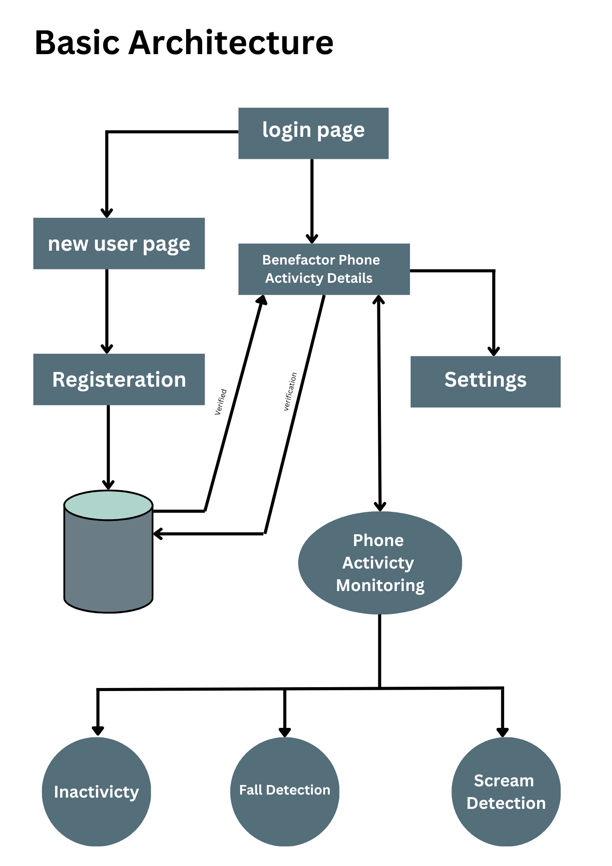
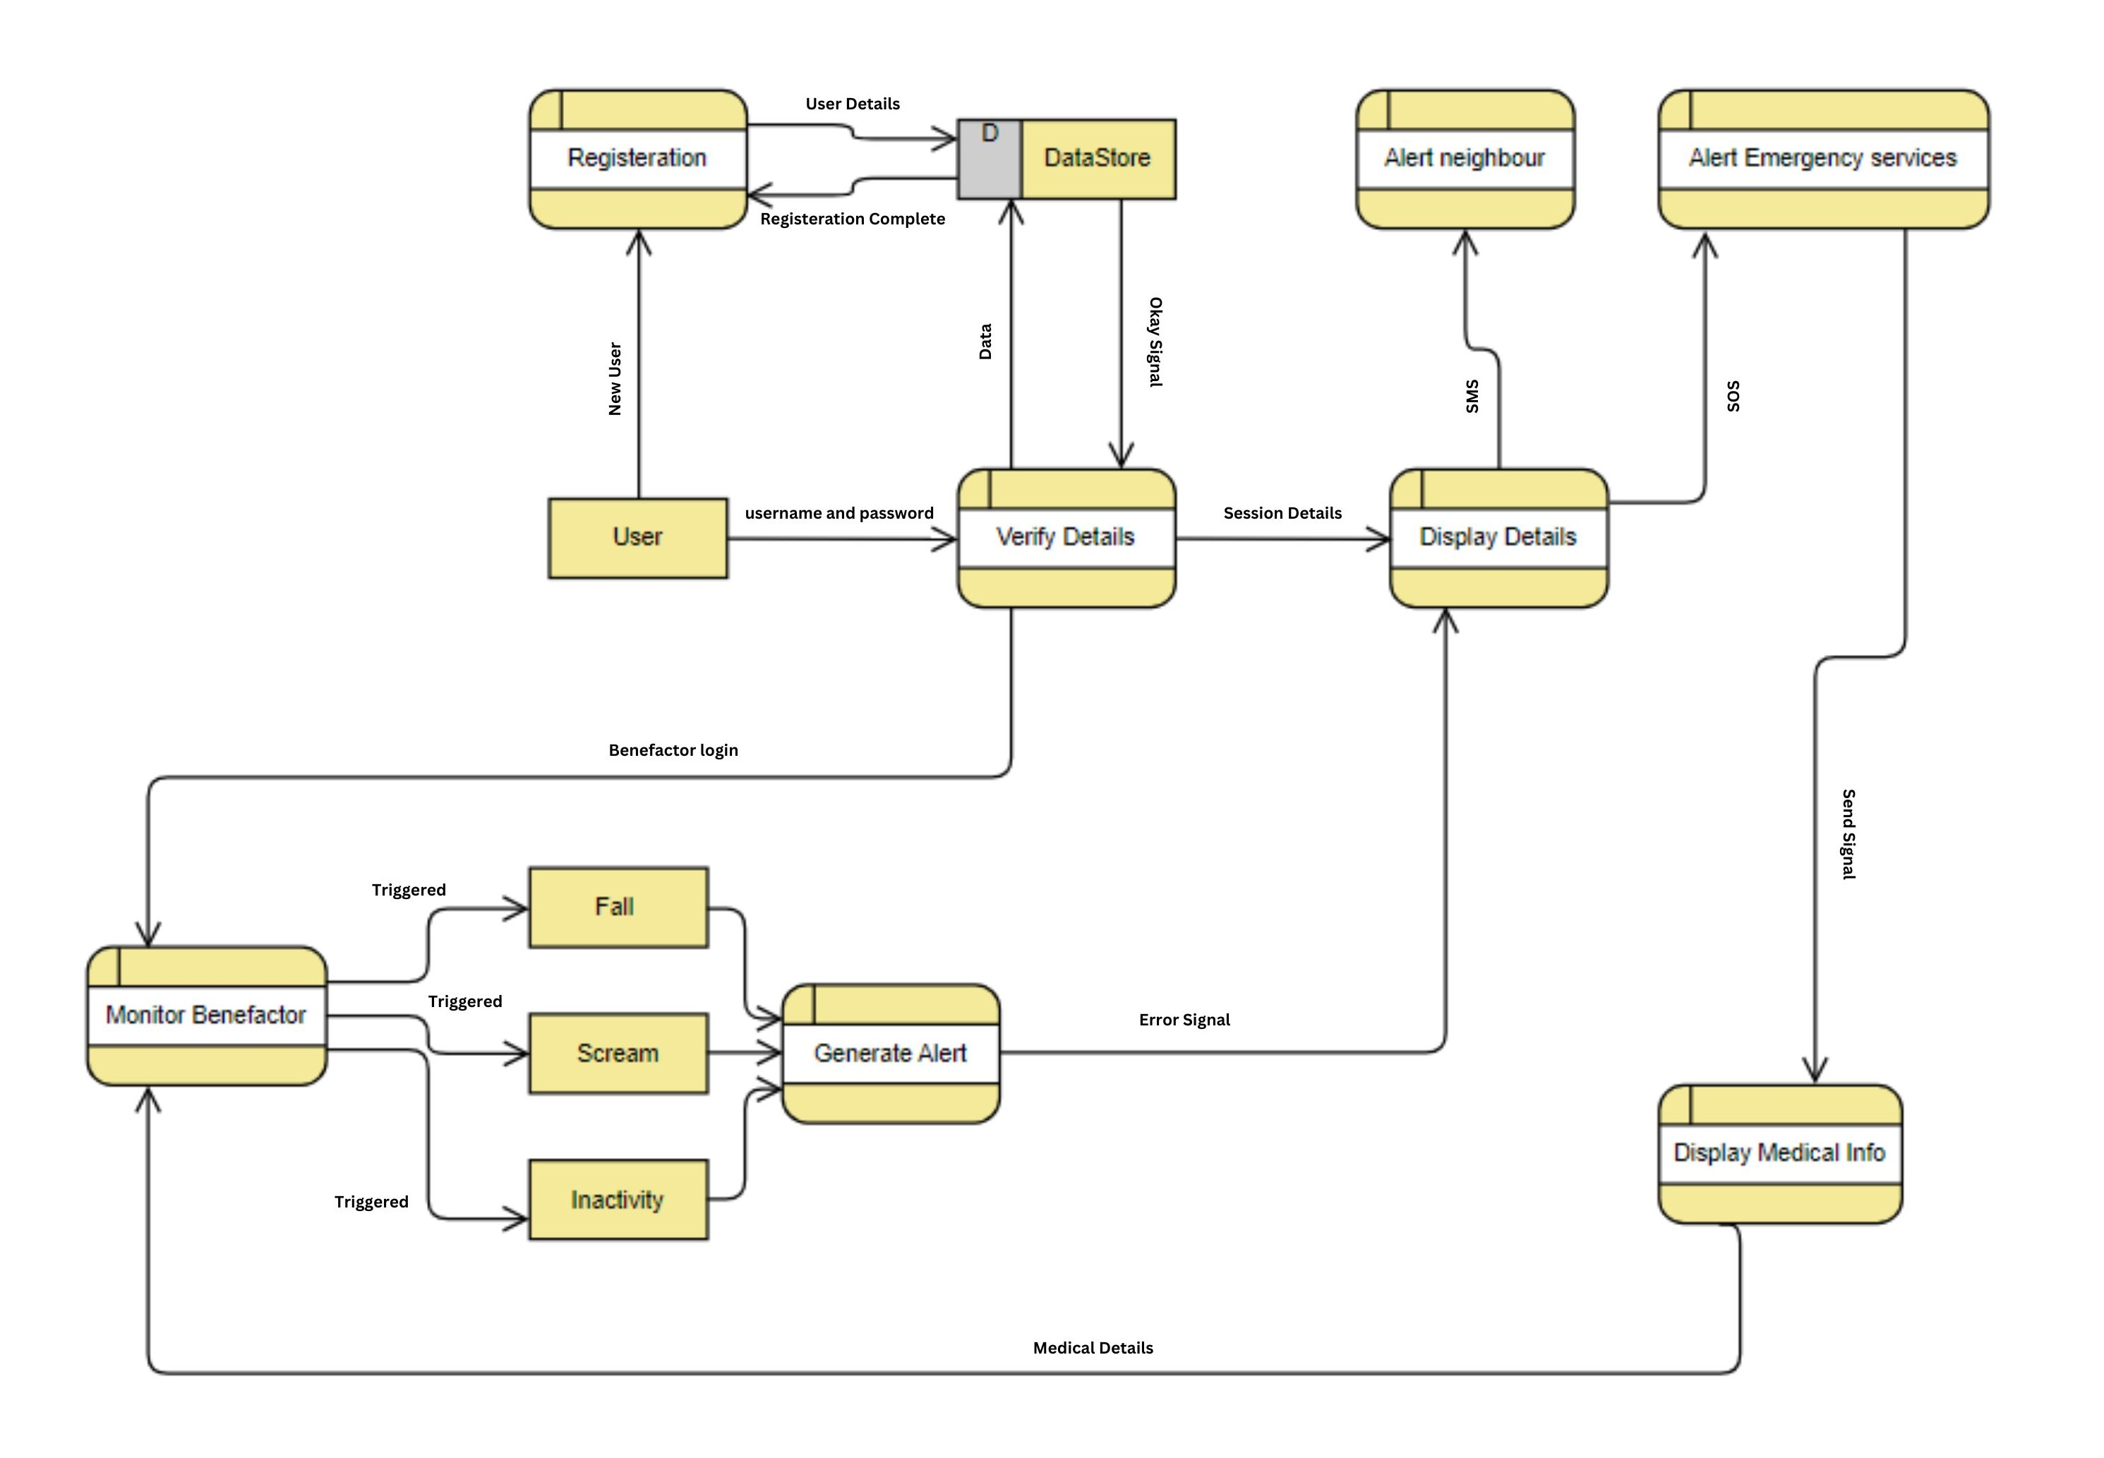
Basic Architecture
DFD

Slide 7
Main Algorithm
1. Input login details or select new user
2. For new user do
2.1 Set username and password
2.2 Verify password conditions
2.3 add details to database
2.4 redirect to login page
3. In login page do
3.1 Verify username and password
3.2 if correct go to step 4 else display “wrong credentials”

Slide 8
Main Algorithm
4. On benefactor side
4.1 Display Alert button , if clicked send Alert
4.2 Monitor gyroscope, Microphone if Sudden change do
wait for 30 seconds
if not okay then
send alert
else
cancel alert

Slide 9
Main Algorithm
4.3 Monitor Phone Inactivity
if inactive time > inactive duration
display “are you okay?”
if Yes then
cancel alert
else
Send alert
4.4 if phone unlocked
reset inactive time

Slide 10
Main Algorithm
5. On Caretaker side
5.1 Set benefactor details such as medical info , maximum time of inactivity before alert
5.2 Display inactive time and last phone unlock , fetch neighbour details (optional)
5.3 Display check button
if clicked then
send “are you okay?” message
5.4 Display Alert neighbour button (if exists)
if clicked then
send message to contact given

Slide 11
Software and hardware specifications
This app assumes the following
Both benefactor and caretaker phone has basic SMS facilities
Benefactor phone has a working microphone and gyroscope
Operating System:
Android: Android 12 or later is officially supported
RAM : 512 mb minimum
Storage : minimum for the app (atleast 100mb free)

